Slide 1
Visual SLAM Approaches
Blake McHale, Ziyi Yang, Nanday Kerkar

Slide 2
Overview
Testing and evaluation on various Visual SLAM approaches:
MATLAB
OpenVSLAM package
RTAB-Map package
Analysis on two datasets: NEU dataset, KITTI dataset
Comparison of performance on different datasets with the packages

Slide 3
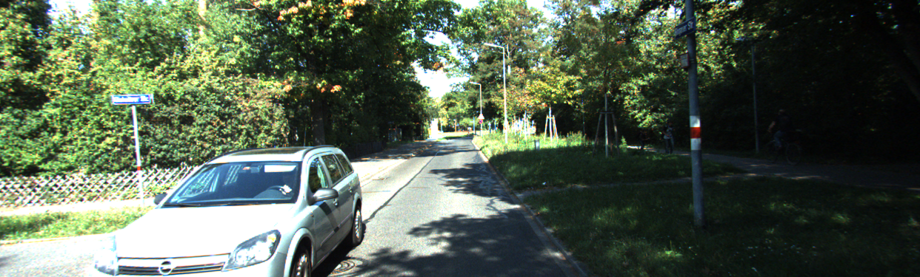
Dataset
Attempted implementation on NEU dataset
There were issues regarding camera_info messages and feature detection
Used KITTI dataset (Residential) to test and evaluate packages
KITTI dataset provides clearer and more distinct images

Slide 4
Explored Packages
Matlab
Our own implementation
SOFT-Odometery package: performs stereo visual odometry
RTAB-Map: ROS built package that performs visual SLAM
OpenVSLAM: can perform visual SLAM with a variety of camera types
Notes:
SOFT-Odometry: https://github.com/Mayankm96/Stereo-Odometry-SOFT (GitHub Repository)
RTAB-Map: http://wiki.ros.org/rtabmap_ros (Documentation)
https://github.com/introlab/rtabmap_ros (GitHub repository)
OpenVSLAM: https://openvslam.readthedocs.io/en/master/index.html (Documentation)
https://github.com/xdspacelab/openvslam (GitHub repository)

Slide 5
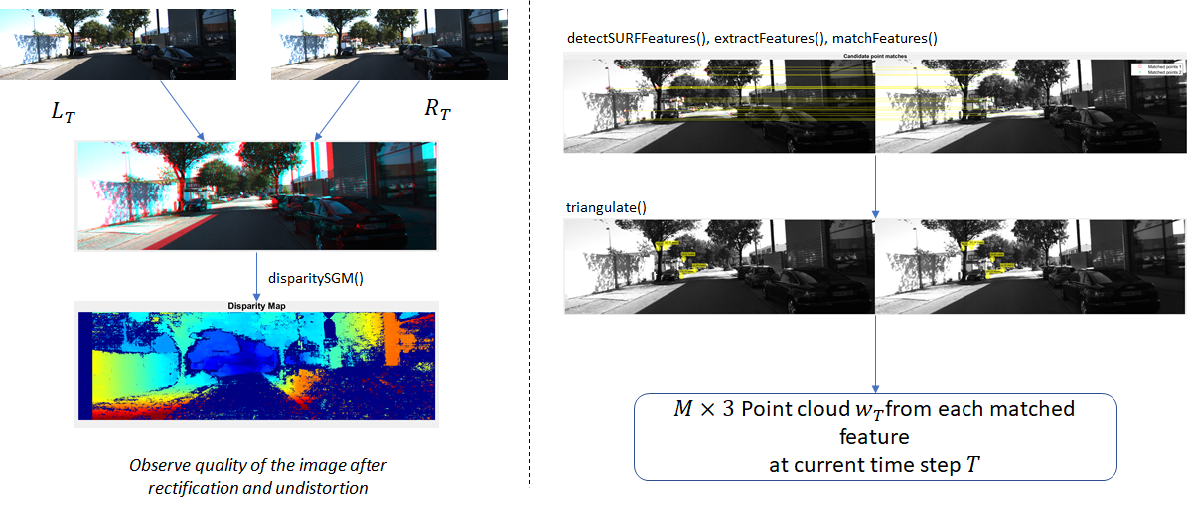
Point Clouds from Stereo Images
Notes:
On the left side, we used disparity map to visualize the quality of stereo images. We can see the trees from far side to near, which means the quality is good for the next step.
On the right side, we implement feature detector to obtain strongest features from left image and right image and then match them in terms of location and strength. Once we got a list of matched points, we can use triagulation to obtain a point cloud rsepected to the coordinate of left camera.

Slide 6
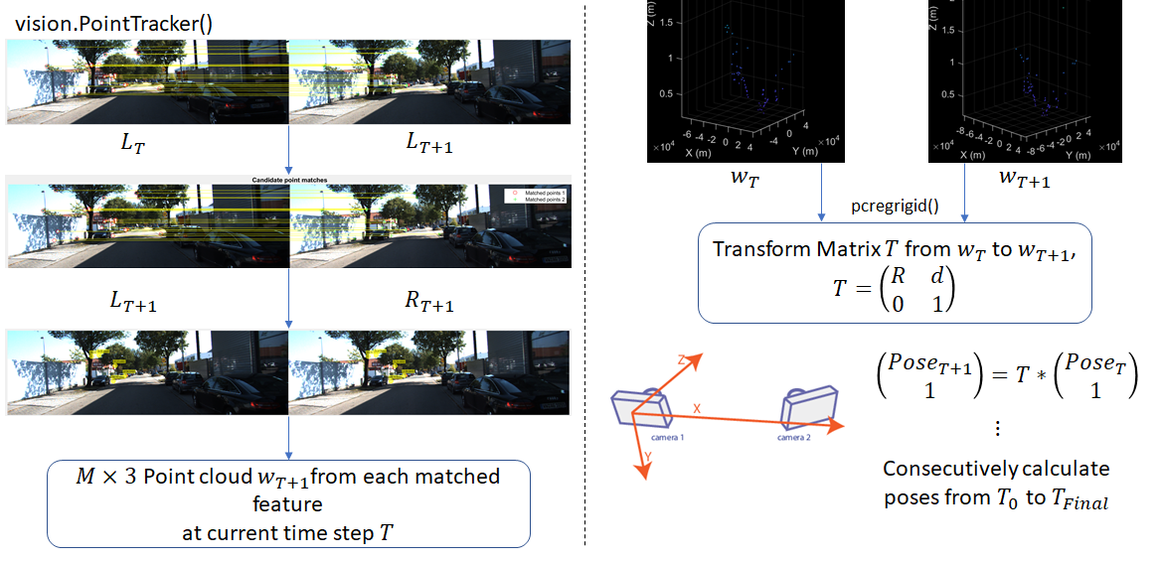
Point Clouds from T + 1 time step & Matching
Notes:
On the left side, we use pointtracker function to track features from left image of previous time step to current time step, and then track those points again into the right image of current time step. Again we will obtain a point cloud at this time step. This process is called circular matching.
On the right side, we continue to calculate the displacement by estimating transform matrix of the point cloud from previous time step to current time step, and by doing this we can further continue the whole process iteratively and get the pose of each time step just like forward kinematic.

Slide 7
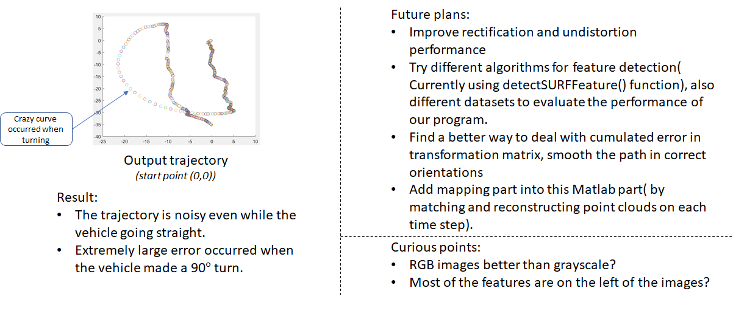
Matlab Result
Points to Note:
Try different algorithms for feature detection, and find a better(best) detector to improve the performance during the turning.
Remove outliers to reduce the noise, smooth the trajectory in correct orientations.
Adding mapping part into Matlab code( by matching and reconstructing points clouds on each time step)
Notes:
This page is wrote for presentation

Slide 8
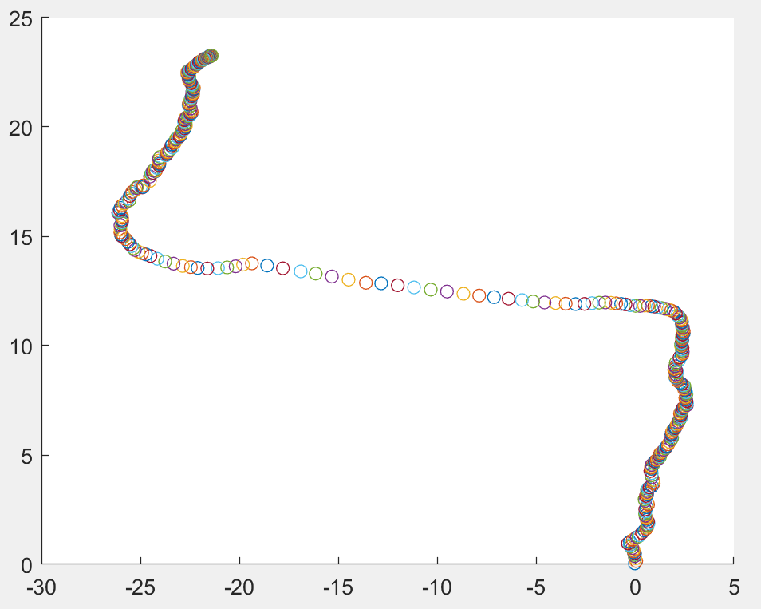
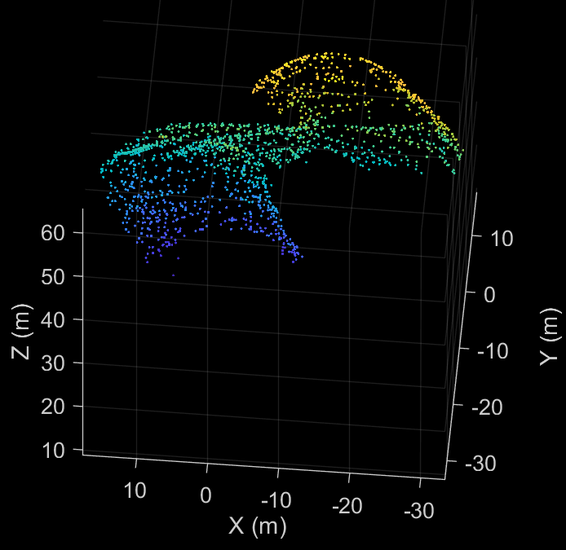
Result after Tuning
Progress:
Outlier removed, so the trajectory is smoother when the vehicle is moving straight.
Applied a better feature detector and divided image into grids, which resulted in a better tracking effect while the vehicle is turning.
Merged point clouds of each time step into a map.
Weakness:
Turning issue still remains. Though it’s turning to the right direction, the turning speed still apparently to be unreasonable, which indicate that losing tracking points happens when the vehicle is turning .
Translation matrix calculation still vulnerable to noise, for example: another vehicle coming from the other side will result in a left displacement in the trajectory.
Haven’t find a way to do calibration of calculation of translation, which makes the system error accumulated. One significant issue is that the vehicle should be stable in the last few time steps but we can see it’s actually moving straight slowly in the trajectory .

Slide 9
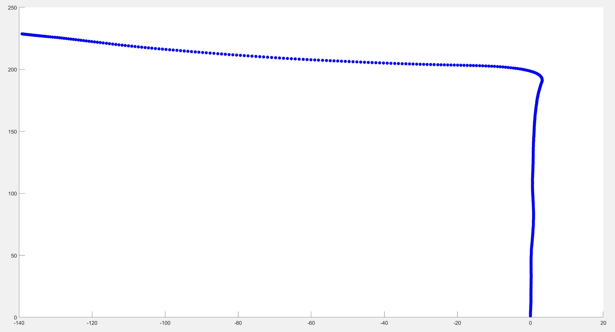
Result after replacing with SOFT Odometry VSLAM
Improvement from last step:
Trajectory further smoother, and much closer to reality.
Turning issue addressed perfectly, and it performs really well in the details of the left turn
Result after applying SOFT Odometry VSLAM package

Slide 10
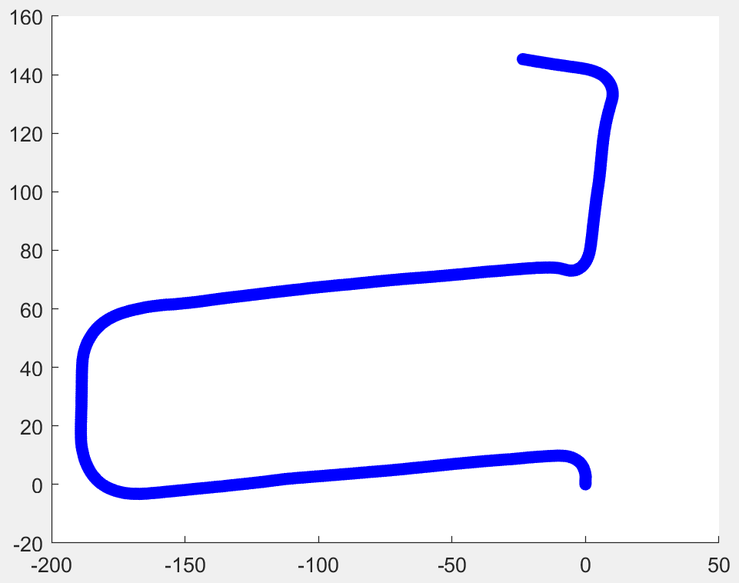
Result after replacing with SOFT Odometry VSLAM
Why does it perform so good?
Better detector, which divides images into more tiny grids and thus can detect around 900 features per stereo image, which result in a better matching process applying RANSAC, so it’s not likely to lose tracking when the vehicle is turning.( But more time-consuming)
Better outliers remover function, applying outliers removal during the whole circular matching process(L0 to R0, L0 to L1, L1 to R1 and also R1 to R0), which significantly reduce noise and system error.(But also time-consuming)
Cons:
Since the algorithm is really time-consuming, mapping is not feasible to be a part of the whole process, neither can it get the trajectory from a huge dataset in reasonable time.
Result after applying SOFT Odometry VSLAM package
(using same dataset as RTAB map and openVSLAM)

Slide 11
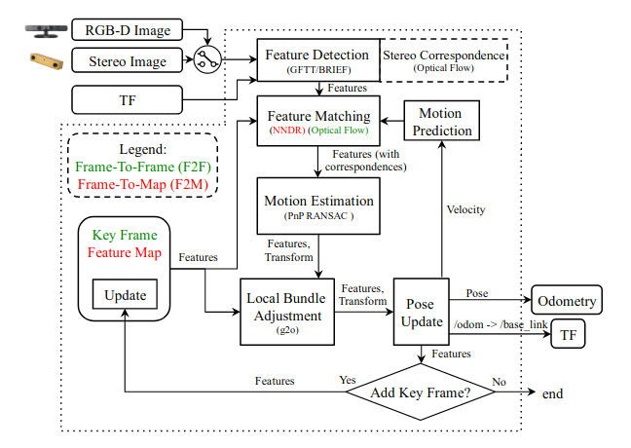
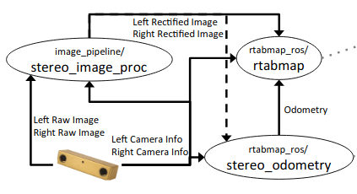
RTAB-Map Structure
Notes:
RTAB-Map Structure:
Inputs
Stereo, lidar, RGBD, and TF
Used Stereo and TF for this project
Feature Detection
Used Good Features to Track algorithm
Generated motion estimations with features and camera intrinsics/extrinsics
Frame To Frame method was used instead of Frame to Map since it was more effective
Feature Map
Generated map with feature detections at given locations and adjusted pose based on detecting previously mapped features
ROS Nodes
Used ROS node structure of package to rectify images from raw image and camera info
RTAB-Map runs two separate nodes: rtabmap and stereo_odometry
Rtabmap produces and checks for feature detections against the map
Stereo_odometry produces pose estimations using just stereo image inputs and feeds it into rtabmap

Slide 12
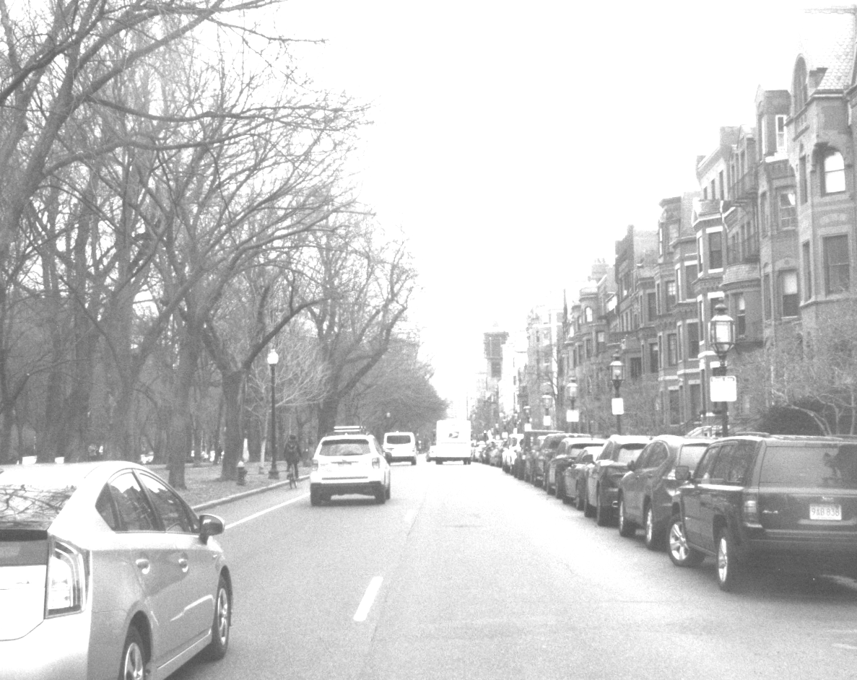
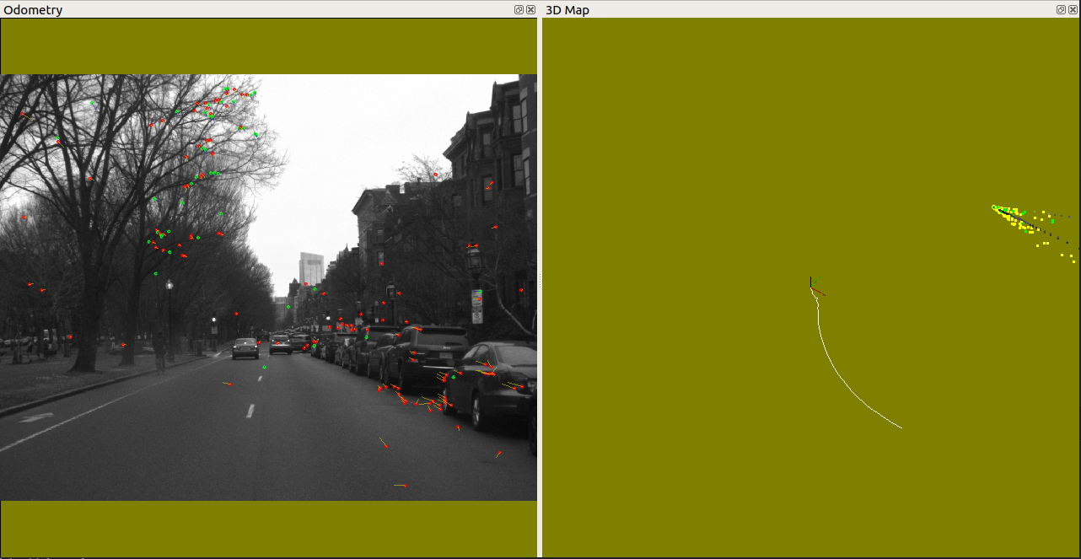
RTAB-Map Analysis (NEU Dataset)
Issues tracking features and maintaining odometry
Tested various feature detection strategies
Changed thresholds for feature detection
Notes:
Issues:
Could not match corresponding features in stereo image
Captured turn effectively, but could not get pose on straight paths
Lost odometry if it did not find enough inliers, which is the case with the bottom left image
Attempts at fixing:
Used various feature detection strategies and modified corresponding parameters
Tested GFTT, ORB, and SURF by changing RTAB-Map parameter for Vis/FeatureType
Manipulated image
Used mask and tried running with only looking at a Region of Interest
Converted color image to grayscale
Modified exposure of image to make obstacles more distinct in color and grayscale image (Right image shows increased exposure)

Slide 13
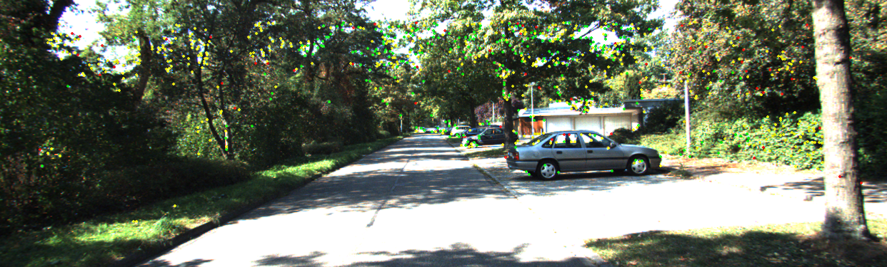
RTAB-Map Analysis (KITTI Feature Detection)
Notes:
KITTI Feature Detection
Performed significantly better with RTAB-Map
Image is very contrasting
Green dots are successful feature matches between frames (inliers), yellow dots are not matched features from previous frames, red dots are outliers

Slide 14
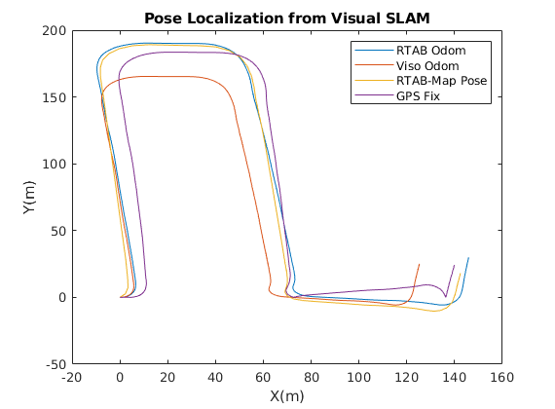
RTAB-Map Analysis (KITTI Pose Estimation)
Used 4 different poses:
RTAB Odometry
Viso2 Odometry
RTAB-Map Localization Pose
GPS Fix
RTAB-Map allows for input from other Visual Odometry libraries (Viso2, etc.)
Notes:
KITTI Odometry Estimation
Plotted 4 different generated pose estimations
RTAB Odometry consists of pose estimations just from RTAB’s stereo odometry node (without SLAM)
Viso2 Odometry is a ROS package that performs stereo odometry similar to RTAB Odometry
RTAB-Map Localization Pose is the generated pose using both the pose estimation from either visual odometry method (RTAB or Viso2) and the map from RTAB-Map
GPS Fix is the pose found by just plotting the GPS from the vehicle
RTAB-Map can perform its own visual odometry or take in outside odometry packages
Viso2 is an example of how RTAB-Map can use an outside package to perform pose localization

Slide 15
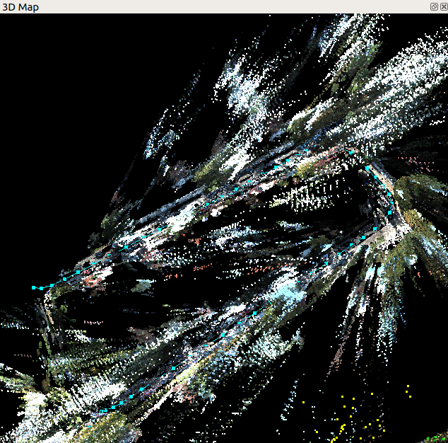
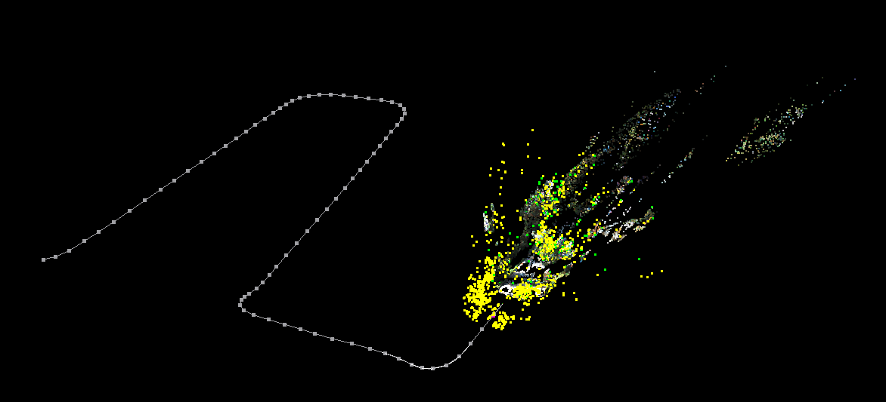
RTAB-Map Analysis (KITTI Map Generation)
Notes:
RTAB-Map Analysis
The picture on the left shows a generated trajectory and map from RTAB-Map
The picture on the right shows all of the stored point clouds for the map being displayed
The dotted line consists of all nodes generated for the map and each node contains references to past feature detections
Past feature detections are matched against current feature detections and the pose is updated according to this

Slide 16
RTAB-Map Review
Performs well on KITTI dataset
Cannot successfully complete a full run with NEU dataset because of lack of feature detections to generate odometry estimates
Versatile package that can use many different sensors
Well documented repository with many tutorials
Provides easy method to tune various parameters of mapping and feature detection algorithms

Slide 17
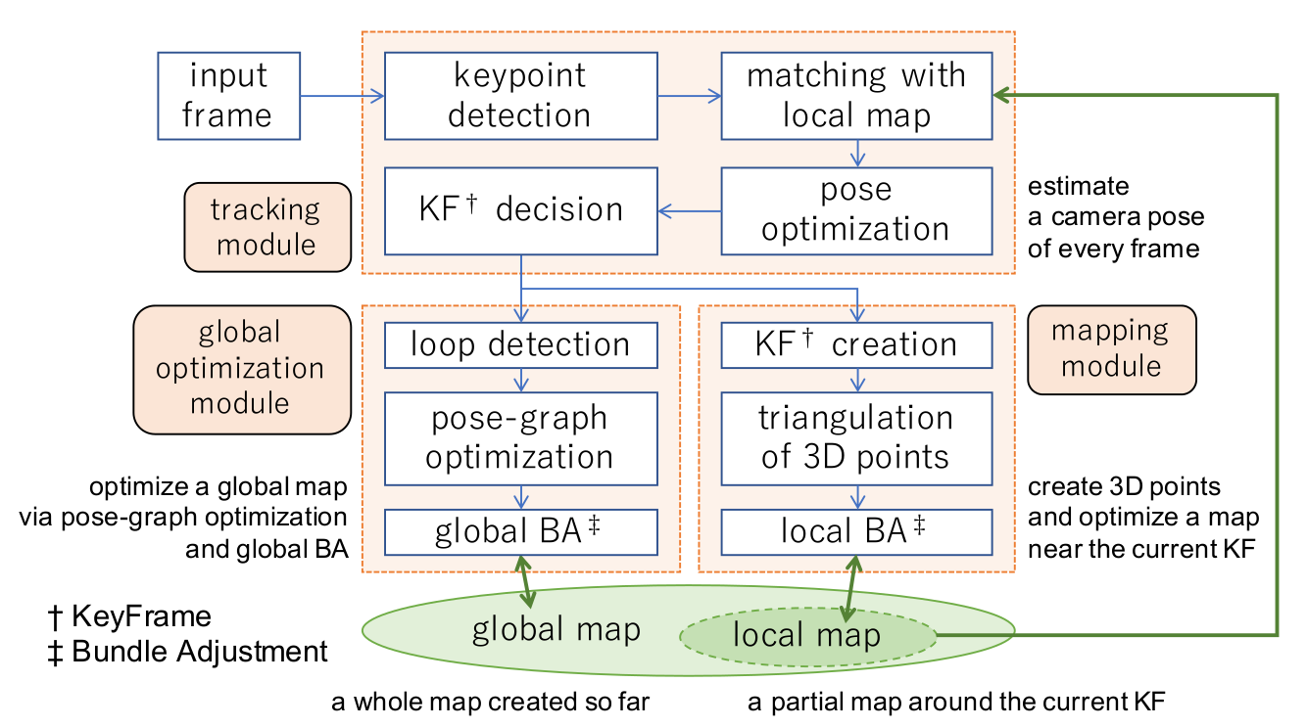
OpenVSLAM
Notes:
The software of OpenVSLAM is roughly divided into three modules, as shown in in above figure: tracking, mapping, and global optimization modules.
The tracking module estimates a camera pose for every frame that is sequentially inputted to OpenVSLAM via keypoint matching and pose optimization. This module also decides whether to insert a new keyframe (KF) or not. When a frame is regarded as appropriate for a new KF, it is sent to the mapping and the global optimization modules.
In the mapping module, new 3D points are triangulated using the inserted KFs; that is, the map is created and extended. Additionally, the windowed map optimization, called local bundle adjustment (BA), is performed in this module.
Loop detection, pose-graph optimization, and global BA are carried out in the global optimization module. Trajectory drift, which often becomes a problem in SLAM, is resolved via pose-graph optimization implemented with g2o. Scale drift is also canceled in this way, especially for monocular camera models.
Local map and Global map will be visually seen in the following slides.

Slide 18
Points to note:
Versatile
Compatible with a variety of camera models
Customizable to add new cameras
Maintained regularly with elaborate documentation for installation and running sample runs
Maps
Maps can be stored while mapping and loaded for localization
Disadvantages:
Only basic incorporation of ROS makes working with topics and nodes difficult
Requires data with distinct features for good results
Implementation:
Implemented for monocular camera setting in this project

Slide 19
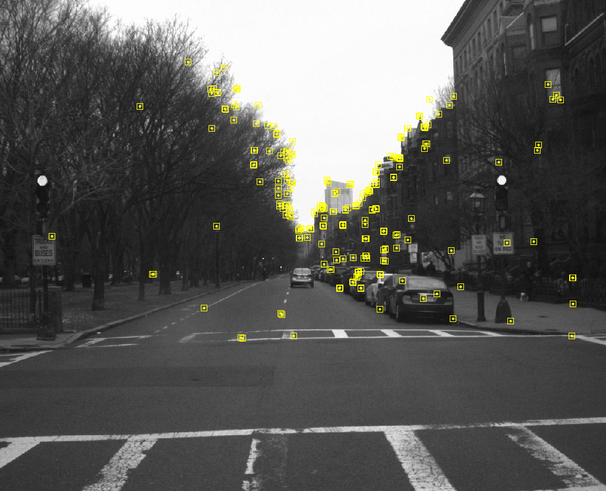
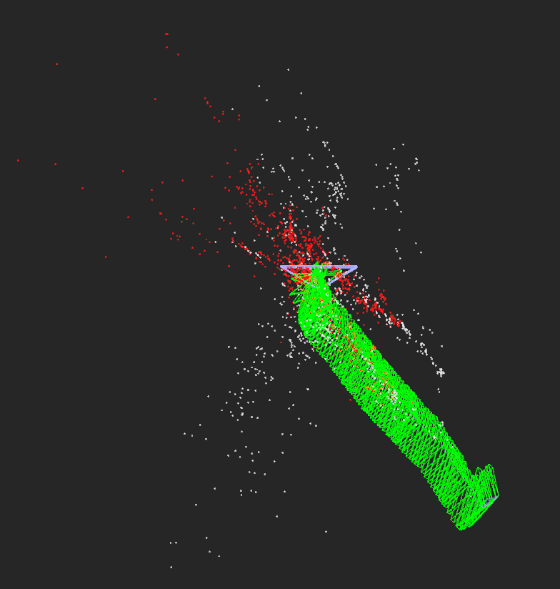
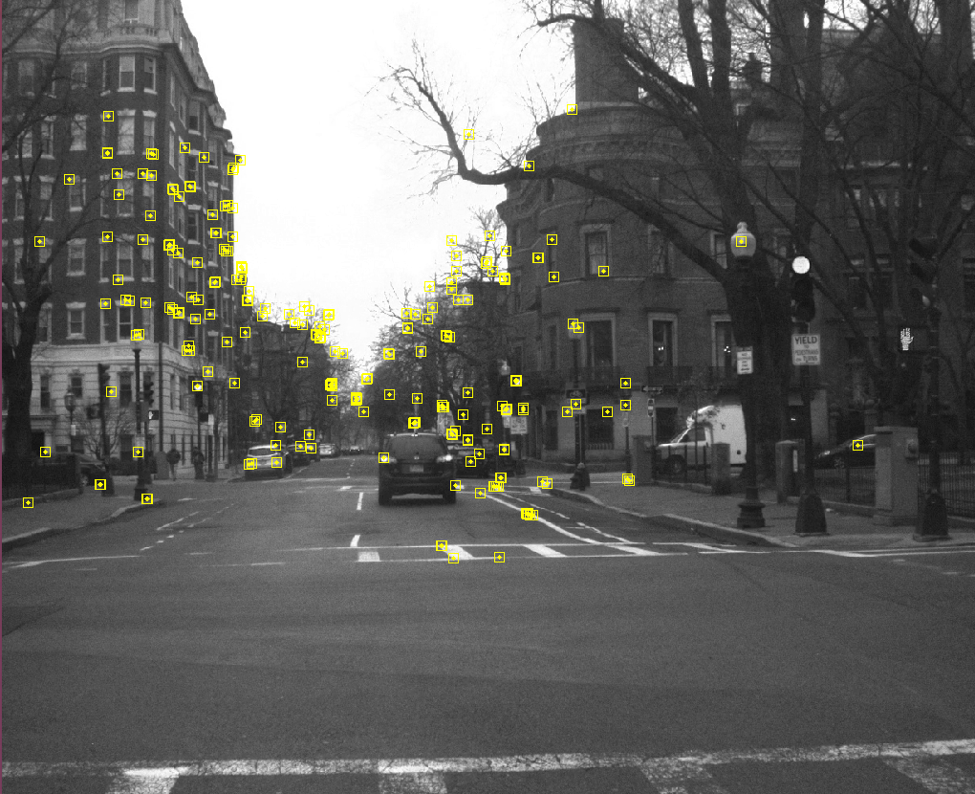
SLAM Results with NEU data
Notes:
Not enough features detected on turns to keep track of lateral movement. This results in the algorithm losing track of movement of the camera at turns.
Detects features and keeps track of these features over slight movements in a more or less straight line movement.
Initial analysis pointed to concentration of features at certain areas of strong contrasts. To counter this, masking, changing image properties, and changing various configuration parameters was tried out but that did not work successfully.
Video of SLAM implementation of the Northeastern University data is available at https://drive.google.com/file/d/1NZyt2z9RmQRFM-Bn86z8-jv-riXXSzOM/view?usp=sharing.

Slide 20
Issues when working on NEU Data
Corrective measures attempted
Loss of features on sharp turns that leads to reset of map at sharp turns
Features were more concentrated towards centre of image and extremely sharp contrasting sections only
Difficult to extract data using ROS features with OpenVSLAM
Masking
Optimization of image properties
Configuration changes
Examined working on numerous KITTI datasets to understand issues

Slide 21
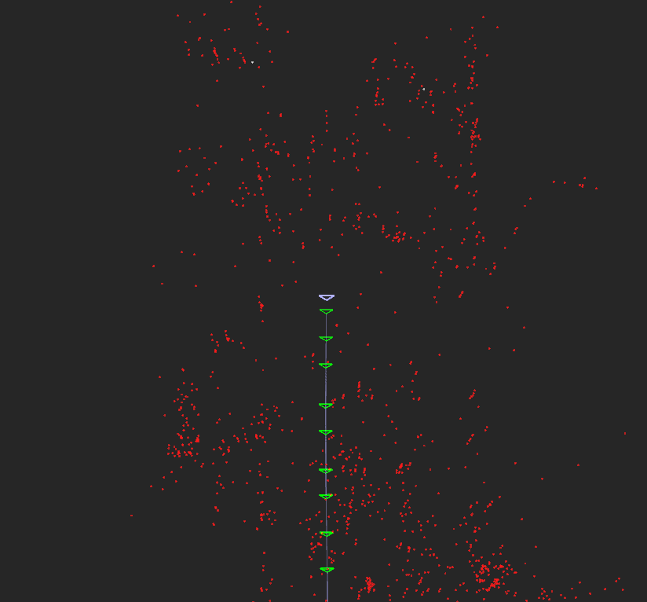
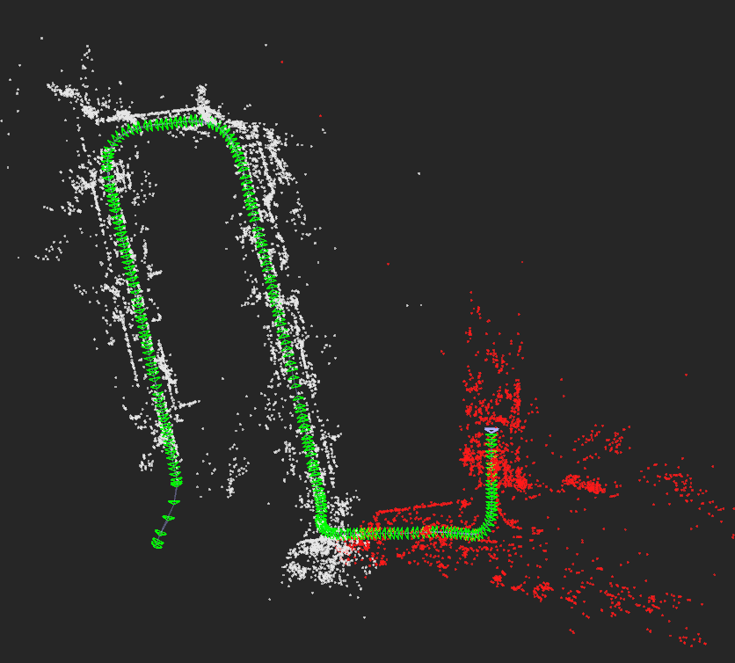
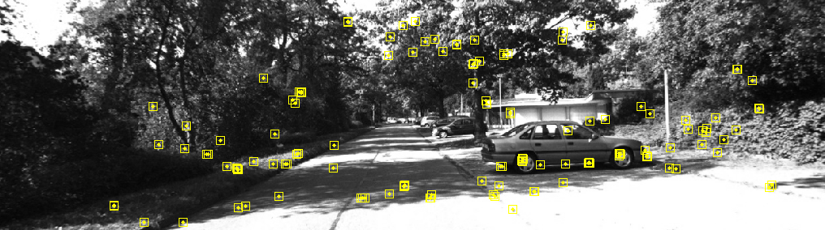
SLAM Results with KITTI Data
Notes:
The KITTI dataset worked really well with OpenVSLAM. Numerous datasets from this source were tried and each one worked really well.
Yellow squares on image represent the features detected and tracked as the camera moves.
The green rectangles represent the location of the camera with respect to the features detected.
The entire group of green triangles represents the trajectory as plotted by OpenVSLAM.
The red dots in the top-right image represent the local map from the block diagram explained earlier. The white and red dots together represent the global map.

Slide 22
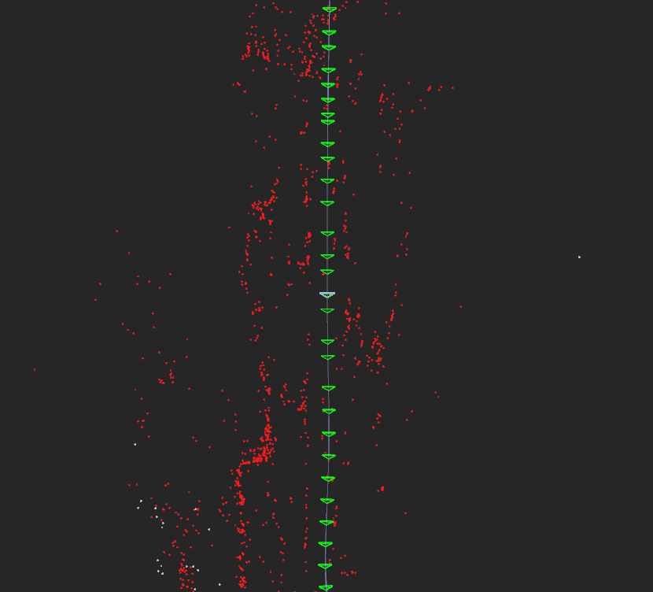
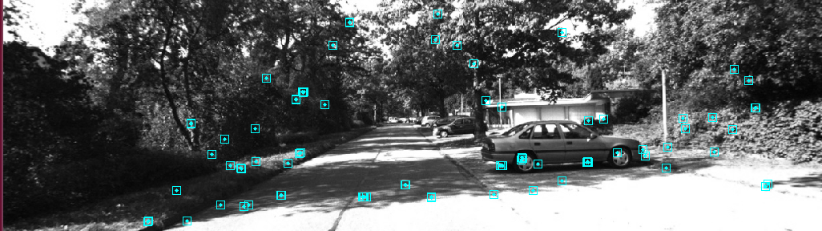
Localization Results with KITTI Data
Notes:
Localization works well with both data sets. But due to errors with SLAM on the NEU dataset, the map is generated incompletely. Hence, localization works only on the part of map the has been generated and stored in the map.msg file in the SLAM stage.
Blue squares are the matched features with the stored map.
The red dots are again part of the local map corresponding to the features detected and matched with the map generated in SLAM stage.

Slide 23
Comparison Between Datasets
The packages perform significantly better with the KITTI dataset than the NEU dataset
KITTI dataset has certain distinct features that are easier to detect by the packages under review
NEU dataset is more comprehensive and includes numerous sensors
NEU dataset is easier to work with since it is in a bag file immediately and no conversions have to be done

Slide 24
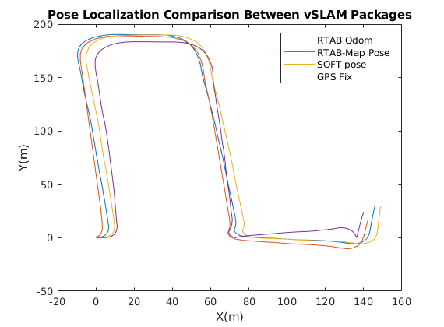
Comparison Between Packages
All packages work extremely well at generating pose estimations
RTAB-Map and SOFT Odometry both generate similar paths
Mapping performs excellently for RTAB-Map and OpenVSLAM, though it does not improve the pose estimation significantly
Notes:
Comparison Between Packages
All packages generated poses very similar to one another
It was difficult to compare pose estimates for OpenVSLAM because there was not an easily accessible interface to record that information
RTAB-Map and SOFT Odometry both provided easily accessible methods for recording poses
Matlab implementation did not have a clear way to perform SLAM with the used visual odometry package and stereo images
Found RTAB-Map was the easiest package to get setup and retrieve information from
This is advantageous for real time systems where an accurate pose estimate may be needed for a task

Slide 25
Conclusion
Matlab: SOFT Odometry works well, however, implementing stereo SLAM is difficult because there are not any clear packages or tutorials available
RTAB-Map: is a good method to work on visual slam and numerous sensors together to generate meaningful outputs. Possible to work extensively with ROS.
OpenVSLAM: is a good method for visual slam when working with variety of camera systems. Not efficient for ROS based working.
RTAB-Map & OpenVSLAM: Results and accuracy of outputs is satisfactory. Versatility to work with variety of data is absent. Needs very clean data which might not always be possible for real-world scenarios.

Slide 26
Thank you
GitLab Repository
https://gitlab.com/mchale.b/eece5554_finalproject/-/tree/master/

